Slide 1

MINI PROJECT PPT
ON
“BANKING MANAGEMENT SYSTEM”
BACHELOR OF COMPUTER APPLICATIONS
Uttaranchal School of Computing Sciences
MENTOR: SUBMITTED BY:
Ms. Noopur Das Bhumika
Ayush Rawat
Roll: - 24,34
BCA- Ist Sem

Slide 2
INTRODUCTION
Banking Management System project is like your digital buddy for easy banking. You know, handling money stuff can be a bit tricky, so I created a simple and friendly program that lets you do basic things like checking your balance, adding money, and changing your password. It's my project for the BCA program, where I get to show off what I've learned about making computer programs. Think of it as your easy-to-use bank on the computer, making everyday money tasks a breeze!"

Slide 3
OBJECTIVE
User-Friendly Banking:
Focuses on creating a straightforward computer program for managing everyday banking tasks.
Account Registration:
Users can sign up by entering details like their name, phone number, and a password, similar to creating their own digital bank account.
Basic Banking Operations:
After registration, users can perform common banking tasks like checking their balance, adding funds, withdrawing cash, and changing passwords.
Digital Piggy Bank:
Visualize it as a digital piggy bank where users can easily keep track of their money and make adjustments as needed.
.

Slide 4
SYSTEM ANALYSIS
EXISTING SYSTEM
When we analyzed that in the management of dairy is working with the manual method. And we all know that the manual system has many disadvantages. Some are mentioned below ……
The Manual system requires more time for processing.
The Manual system has more chances of error.
Difficult to maintain the records.
Manual System is costly.
More man Power is needed.

Slide 5
PROPOSED SYSTEM
As we have analyzed the
Requires less time for completion of any work.
Decrease the chances of error.
Should work smoothly and very fast.
Time saving and man power saving.
User friendly anyone having computer knowledge can handle it easily.
Suitable for computerized data entry. Maintaining dairy information, staff &customer information, Milk rates information.

Slide 6
SOFTWARE & HARDWARE USED
Software used
c ++ /Dev c++
Hardware used
Processor – Intel core i5 11600KF 4.2 GHz
RAM - 16GB
SSD - 512 GB
Operating System -Windows
Technology Used -Python Programming

Slide 7
SYSTEM DESIGN
SYSTEM ANALYSIS AND DESIGN
The way that is followed by carrying on with the development of application is as followed
DEFINING A PROBLEM
Defining a problem is one of the important activities of the project. The objective is to define precisely the business problem to be solved and there by determined the scope of the new system. The phase consists of two main tasks. The fast task within this activity is to review the organization needs to originally initiated the project. The second task is to identify, at an abstract or general level, the expected capability of the new system. Thus, it helps to define the goal to we achieved and the boundaries of your system. A clear understanding of the problem will help us in building a better system and reduce the risk of project failure. It also specifies the resource that have to be made available to the project. Three important factor project goal, project bounce and the resource limits are sometimes called the projects in term of reference.

Slide 8
FUTURE SCOPE
As now the project/software will work upon command prompt in future we will make GUI (graphical User Interface) or web-based software/system so that every user or employee can access it remotely.
Customer also be a user of system.
Performance will be improved day to day users increment.
In future we can convert it in android application (APP).

Slide 9
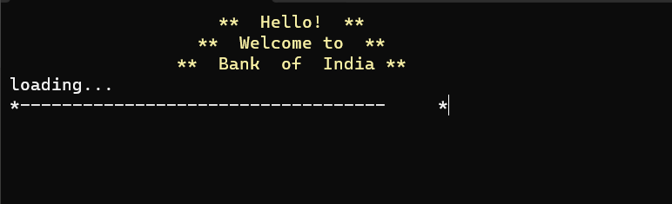
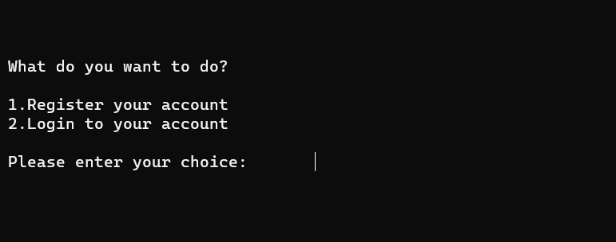
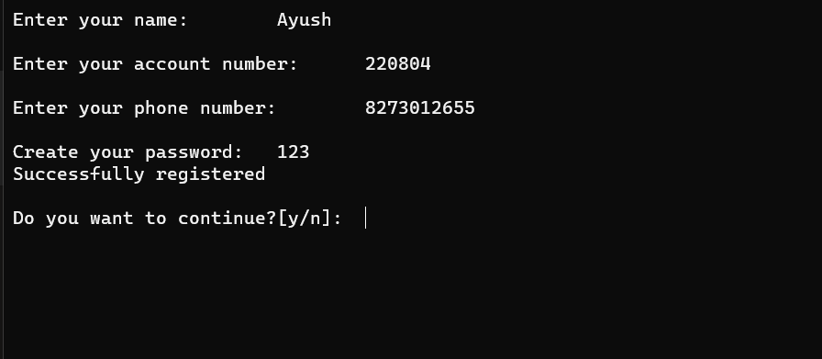
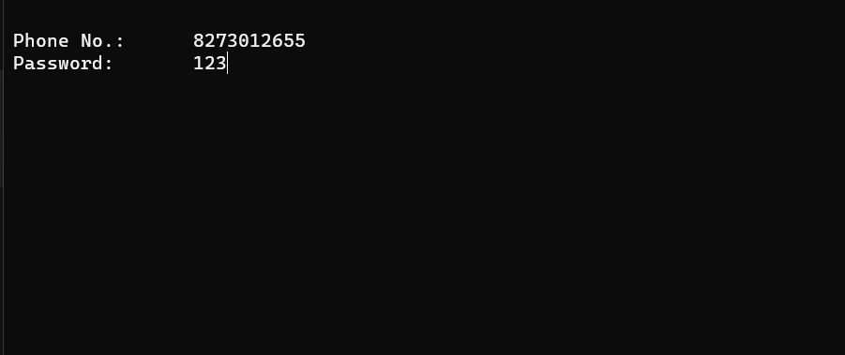
OUTPUT

Slide 10
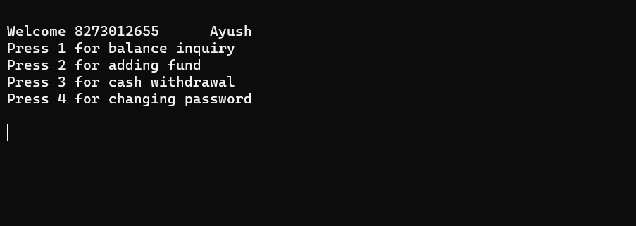
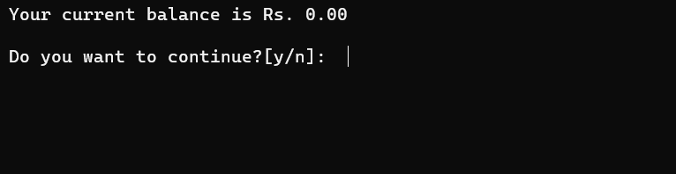
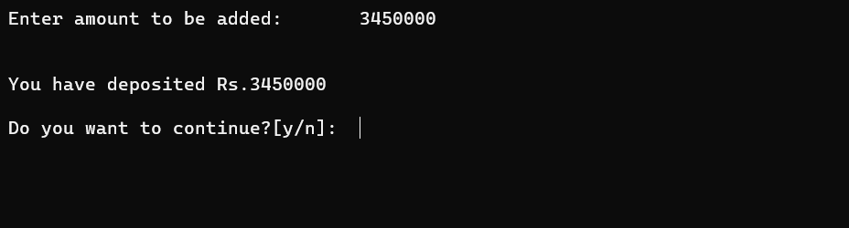
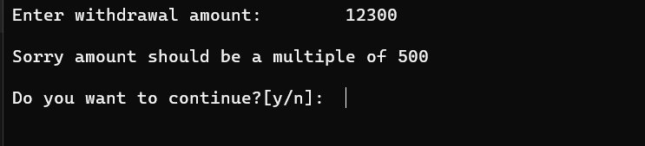
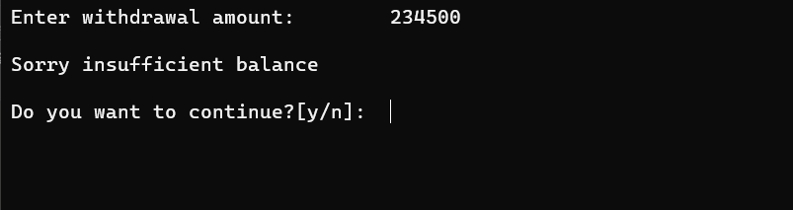

Slide 11
BIBLIOGRAPHY
Google – You tube
visual c++ - Banking System Program - Stack Overflow
Menu-Driven Program for Bank Management System - GeeksforGeeks
ayushrawat220804/My-Projects: hey folks , here are my projects i have builded till now !! (github.com)

Slide 12


